Slide 1

PENETRATION TESTING

Slide 2
THE FINAL REPORT

Slide 3
THE FINAL REPORT
It is time now to send the client a final report with your feedback on all accomplished tasks.

Slide 4
THE FINAL REPORT
It is important to stress how fundamental this part is.
We need to present in a clear and complete manner all the information we gathered as well as each suggestion that could help to correct the weaknesses we spotted out.

Slide 5
THE FINAL REPORT
In addition to the list of vulnerabilities found and exploits used, we should include a part related to the so-called "remediation".
This part is meant to show the customer all the possible remedies for the risks we discovered.

Slide 6
THE FINAL REPORT
It would be better to start the report with a general overview of the actions taken and then gradually enter into detail.
In this way, the report becomes easier to read for members of the management board and non-technicians, who will be able to understand exactly what is been reported.

Slide 7
THE FINAL REPORT
Although we can also include other parts, a well-structured report usually consists of the following sections:
Executive summary.
Methodology used.
Findings.
Remediation plan.

Slide 8
EXECUTIVE SUMMARY

Slide 9
THE FINAL REPORT
The executive summary is the report that can be understood even by non-technical staff, for example by managers.
Remember that different persons may read different parts of the document.
Every part should be self-explanatory and consistent (use references and links)
Important messages must be stated clearly and for first (no suspense!)

Slide 10
THE FINAL REPORT
Declare the scope of your analysis
Although the people reading the report belong to the same organization, they may have different understanding about the infrastructure
The scope is fundamental to allow replication, i.e., to verify the evidences that you reported

Slide 11
THE FINAL REPORT
We must point out the evidences found and their level of criticality.
Emphasize key findings, i.e., the important things that you discovered
Most important findings go first!
When possible, use pictures and graphs to simplify reading and understanding

Slide 12
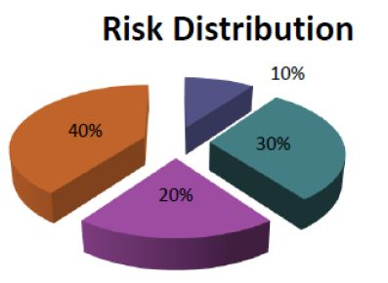
THE FINAL REPORT

Slide 13
METHODOLOGY

Slide 14
THE FINAL REPORT
The methodology used integrates all the phases from the definition of the test scope to the final report.
For instance, the methodology used in this course is:

Slide 15
THE FINAL REPORT
Definition of the test scope.
Information gathering.
Network scanning.
Vulnerability assessment.
Exploitation.
Post exploitation.
Other optional tests.

Slide 16
THE FINAL REPORT
Remember that well-established methodologies exist
If possible, do not reinvent the wheel (and if you have to, make it round at least)
Check existing methodologies, reuse them at least partially, motivate your choices
For instance, for web technologies, you may want to refer to the OWASP testing guide and show that you followed the OWASP checklist
https://owasp.org/www-project-web-security-testing-guide/assets/archive/OWASP_Web_Application_Penetration_Checklist_v1_1.pdf

Slide 17
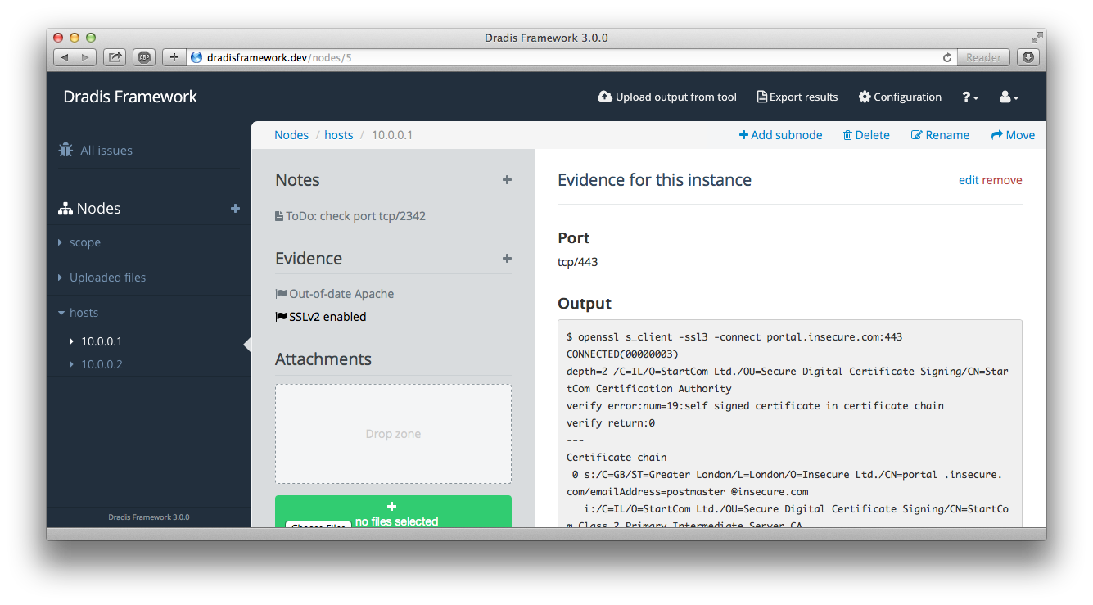
THE FINAL REPORT
Writing a report is often a collaborative task
Take advantage of automatic tools if you can
E.g., Dradis. https://dradisframework.com/

Slide 18
THE FINAL REPORT
If your activity involved social engineering steps, you should also report it
For instance, you may include emails or phishing web pages
However, here it is not important “how” (e.g., how we came out with this spear phishing mail for someone) but “what” (e.g., someone is vulnerable to spear phishing mails such as this one)

Slide 19
FINDINGS

Slide 20
THE FINAL REPORT
The first task to complete in this sub-phase is defining the risk level of the various vulnerabilities you detected
There are several ways to estimate the risk

Slide 21
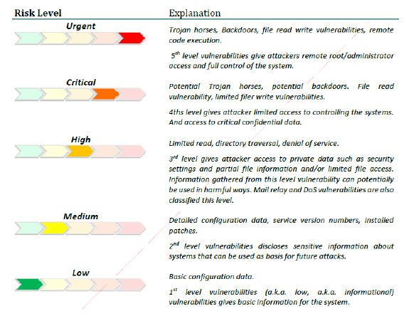
THE FINAL REPORT

Slide 22
THE FINAL REPORT
It is also important to consider existing frameworks for evaluating the severity of vulnerabilities
For instance the Common Vulnerability Scoring System https://www.first.org/cvss/
It computes a score based on several aspect such as the required privileges, the attack vector and the exploitation complexity
https://nvd.nist.gov/vuln-metrics/cvss/v3-calculator

Slide 23
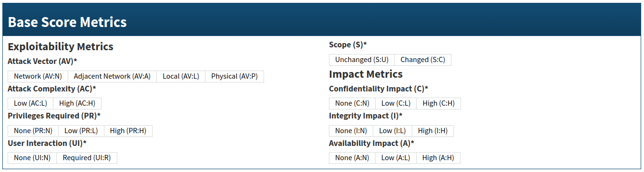
THE FINAL REPORT

Slide 24
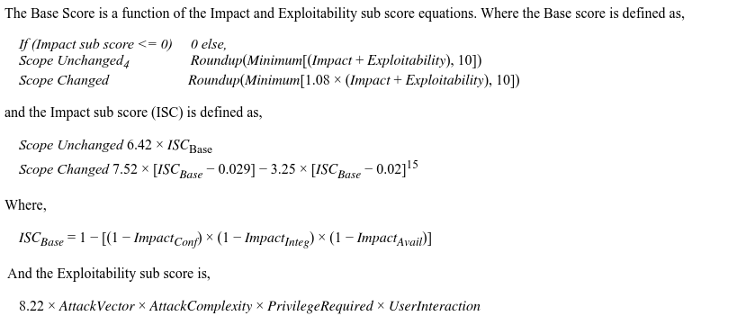
THE FINAL REPORT

Slide 25
THE FINAL REPORT
Once we have all the scores we can list all the vulnerabilities ordered by priority
Each vulnerability must be associated to a section of the report
Sections include a detailed description, instructions and evidences for replicating the attack (e.g., screenshots and schemas) and the remediation plan
Also consider providing a script to automate the exploit

Slide 26
REMEDIATION PLAN

Slide 27
THE FINAL REPORT
The remediation plan has two aims:
explain how to fix/mitigate the existing vulnerabilities
help in defining a prioritization/strategy

Slide 28
THE FINAL REPORT
Prioritization is provided by the scoring system
Severe vulnerabilities go first
However, the fixing order may be very different, depending on contextual factors
E.g., the functional requirements of the infrastructure

Slide 29
THE FINAL REPORT
Recommendations must provide few alternatives on how to cope with a vulnerability
For instance, we may distinguish between patches, mitigations and workaround
The goal is to “harden” the infrastructure

Slide 30
THE FINAL REPORT
Patch: a modification correcting the vulnerability/preventing the exploitation
E.g., install updated versions, modify an implementation, …
Mitigation: a modification that makes the exploitation more complex/costly
E.g., make users change their password more frequently
Workaround: a modification that reduces the impact of an exploit
E.g., backup the system, add IDS and rules alerting the administrator

Slide 31
THE FINAL REPORT
https://www.offensive-security.com/reports/sample-penetration-testing-report.pdf

